Slide 1
Task 4: Hydrology Mapping
UNCLASSIFIED
Chuck Downer
Mark Wahl, Joseph Gutenson, Todd Steissberg, Nawa Pradhan
DoD Component: Dept. of Army
Controlled by: CEERD-HF-H
CUI Category: CTI
Distribution/Dissemination Controls: FEDCON
POC: Chuck Downer; Charles.W.Downer@erdc.dren.mil
DISTRIBUTION C. Distribution authorized to U.S. Government Agencies and their contractors. Other requests for this document shall be referred to the U.S. Army Engineer Research and Development Center, 3909 Halls Ferry Rd, Vicksburg, MS 39180.
Overall Classification of Briefing is CUI
UNCLASSIFIED
Notes:
Check Distro Statement, update overall classification, and update authors.
If no CUI, then remove gray box with dissemination controls.

Slide 2
Capability Set 27 Design Goal 5
Intelligent Environmental Battlefield Awareness: Task 6.2: Hydrology Mapping (FY22-24)
Task 6.3 Hydrology Mapping Demonstration(FY23-26)
SUMMARY
Goal (what are you trying to do?/Problem trying to solve?):
Provide Army mission planners with predictions of soil moisture state, infiltration, runoff and water levels that better reflect the high degree of spatial and temporal variability in ground and surface water threats.
If successful, what difference will it make?
More accurate and timely characterization of the hydrologic environment.
Improved intelligence preparation of the battlefield.
Issues/Risks:
Dependence on the accuracy and completeness of the satellite for population of high resolution models.
Performers (In-house/out-house):
In-house: ERDC CHL, EL, ITL, CRREL
Out-house: LimnoTech
METRICS DATA
PARAMETERS | TECHNICAL METRICS | DEMONSTRATED PERFORMANCE | COMMENTS
Hydrologic—evapotranspiration-vegetation algorithm | Seasonal ET simulations | FY24, Q4 | MSSPIX24
Hydrologic freeze/thaw-infiltration algorithm | High latitude surface runoff prediction | FY24, Q4
Gridded hydrologic overlays in GIS platform | Global channel flow and soil moisture | FY26, Q4 | AGE-NODE
Requirements: MDO TP525-3-1.3-5.d.2, Training and Doctrine CMD 525-3-1, TM No. 3-34.43
Mid-term/Final Measures of Success: Development of the data processing system and validation of the spatially explicit dynamic algorithms. Final success is a field demonstration tool (tool/data informing both the integrated intelligence module and joint partners) incorporating the ground and surface water prediction tool for identification of potential maneuver hazards. Updated release version of GSSHA/GIPL for cold region hydrology.
Transitions: PEO IEW&S, PM-DCGS-A
PROGRESS
Last 6 Month Accomplishments:
Selecting subtask leads.
Develop task PMP.
Develop detailed spending for FY 22.
.
Next 6 Month Plans:
Compilation of software and development of IT infrastructure for high intensity hydrologic modeling
Review of vegetation succession models that can be leveraged for evapotranspiration
Improve initial condition, boundary condition, and model parameterization for grid based hydrologic code

Slide 3
Overview of Team and Research Area
Task Manager: Chuck Downer (CHL)
4.1 Data Integration
Gutenson/Wahl (CHL)
Scott Christensen (ITL)
4.2 Vegetative Controls on Hydrology
Todd Steissberg (EL)
Todd Swannack (EL)
4.3 Spatially Distributed Soil Moisture and Run-off
Nawa Pradhan (CHL)
Ross Alter/Anna Wagner (CRREL)
Chase Hamilton (CHL)
John Eylander (CHL)
Rose Shillito/Steven Brown/ Clay LaHatte (CHL)
John Kucharski (EL)
Jennifer Olszewski (EL)
Chuck Downer (CHL)
Billy Johnson (LimnoTech)
Decades of experience in each sub-task
FORGE THE FUTURE
Notes:
Slide 13- Army recommendations here?
Response: Similar to Heilmeier question - If successful in solving the problem, what difference will it make and why? Who cares? The operational gap the Project is addressing, quantify the metric planned to achieve.
Include freeform slides to show task leads and team structure, discuss the technology, who’s doing what outside of ERDC (assessment of research across the S&T community – other services, DARPA etc)? How much resources are they investing and how do you plan on leveraging?

Slide 4
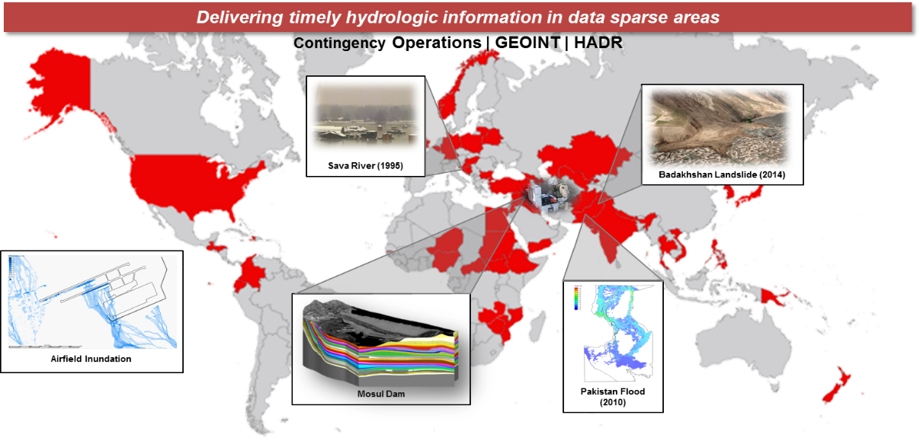
Current State of the Art: Hydrologic Support Occurs via Reachback
DoD Joint Capability Areas require hydrologic information in order to effectively accomplish their mission. E.g. battlespace awareness; risk mitigation; logistical support; and partnership building
Army concerns within the hydrologic domain are currently addressed via ad hoc requests through the USACE Reachback Operations Center (UROC). This approach relies heavily on subject matter expertise and does not scale for potential large-scale conflicts with a near-peer adversary.
There is no authoritative DoD enterprise solution to assess hydrologic impacts on military operations.
FORGE THE FUTURE
Notes:
Similar to Heilmeier question – How is it done today, and what are the limits of current practice?
DoD Joint Capability Areas (e.g. battlespace awareness, risk mitigation, logistical support, and partnership building) require hydrologic information in order to effectively accomplish their mission.
This includes: wet gap crossings; augmented reality; autonomous maneuver; IED detection; flood risk and exposure; climate extremes; contaminant fate and transport; navigability of waterways; off-grid power generation; bridging; fording; base site identification; climate security; water security; food security; drought mitigation; water diplomacy, etc.
There is no authoritative DoD enterprise solution to assess hydrologic impacts on military operations.
As a result, Army needs within the hydrologic domain are currently addressed via ad hoc requests for information through the USACE Reachback Operations Center (UROC).
The current status quo relies heavily on subject matter expertise and involves lengthy response times. This approach does not scale appropriately to meet the demands of potential large scale conflicts.
Future autonomous and semi-autonomous systems will require extensive environmental information to operate effectively on the battlefield. Dynamically changing weather impacts are difficult to assess in data sparse areas, particularly in a disconnected environment such as a battlefield
An operational global hydro-terrestrial modeling framework is needed to better support the DoD Joint Capability Areas with continuous modeling and simulation results available anywhere in the world on demand.
REQUIREMENT: "Army and DOD policy documents place specific responsibility on the USACE as the director and monitor for Army programs in the atmospheric, topographic, hydrographic and terrestrial sciences. This includes providing simulation and visualization of environmental effects on Army assets; supporting and conducting relevant RDT&E activities to provide hydrological studies, forecasts, decision aids, and exploitation tools for military training, operations, and emergency response; and operationalizing and transitioning appropriate technologies to the USAF in support of Army operations. Outside the United States, USACE provides support through modest reimbursable efforts or engineering reachback activities. Alignment of organization strengths and core competencies is needed to field best-in-class tools that provide authoritative information for advanced decision making in support of DOD and USG requirements globally."

Slide 5
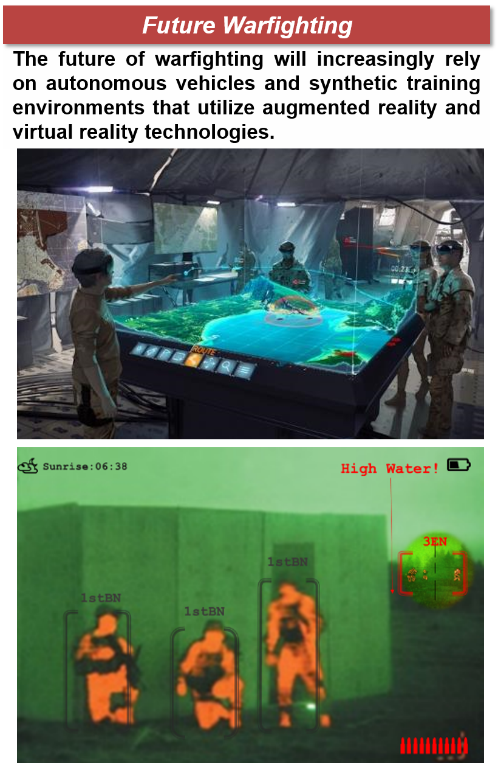
Global Hydrologic Awareness with Local Precision
Reconstruct historical streamflow and soil moisture states in a manner that is spatially continuous using state-of-the-art climate reanalysis datasets.
Characterize seasonal variation, severity and likelihood of impactful events as this relates to estimates of flow velocity, depth, top width, and relative soil moisture and soil strength.
Develop a data model that expresses time-dependent variables with reduced order models (e.g. polynomial expressions) for operating in disconnected environment.
Targeting deployment on the Next Generation Geospatial Work Station and other data services and web applications
Key Takeaway
FORGE THE FUTURE
Notes:
Slide 13- Army recommendations here?
Similar to Heilmeier question - What is new in your approach and why do you think it will be successful? Who cares? If you are successful, what difference will it make? What are the risks?
How much will it cost? How long will it take?
Freeform vs guided chart – Kim will address during discussions.

Slide 6
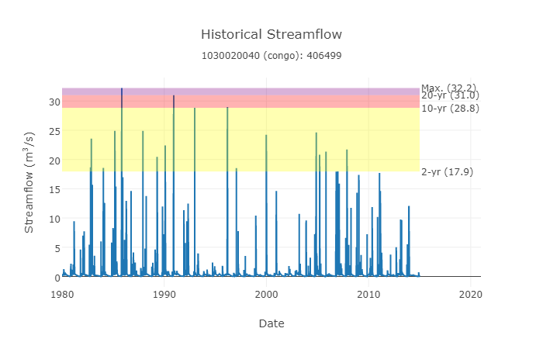

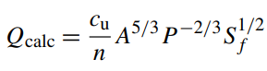
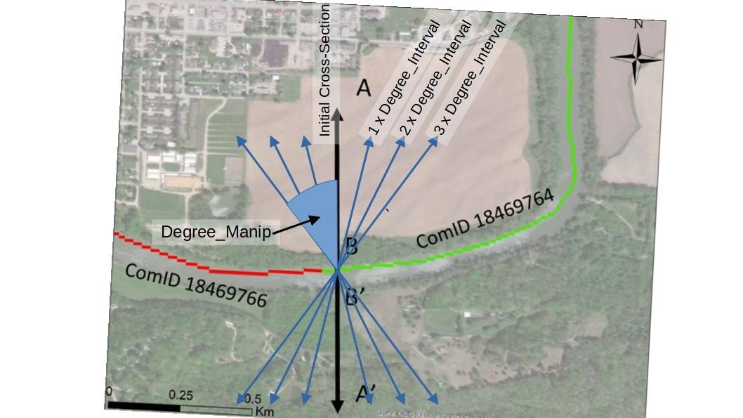

FY22 Overview
Streamflow Distribution
Fraction of Peak Discharge | Q (cms)
1/15 | 2.15
2/15 | 4.29
3/15 | 6.44
…
15/15 | 32.2
Database Containing Discharge (Q), Velocity (V), Top Width (T), and Water Surface Elevation (WSE) that can be used to characterize seasonal variation.
Run Hydraulic Simulations with Streamflow Distribution
Building an authoritative base layer of hydrologic and hydraulic seasonality
FORGE THE FUTURE
Notes:
Slide 13- Army recommendations here?
Similar to Heilmeier question - What is new in your approach and why do you think it will be successful? Who cares? If you are successful, what difference will it make? What are the risks?
How much will it cost? How long will it take?
Freeform vs guided chart – Kim will address during discussions.

Slide 7
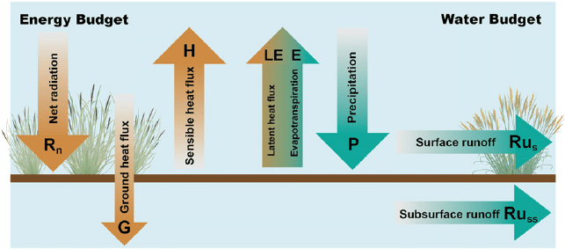
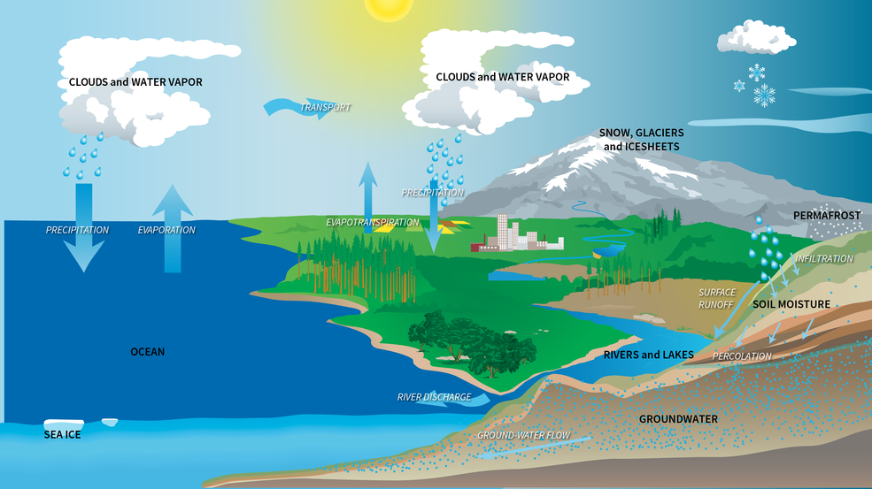
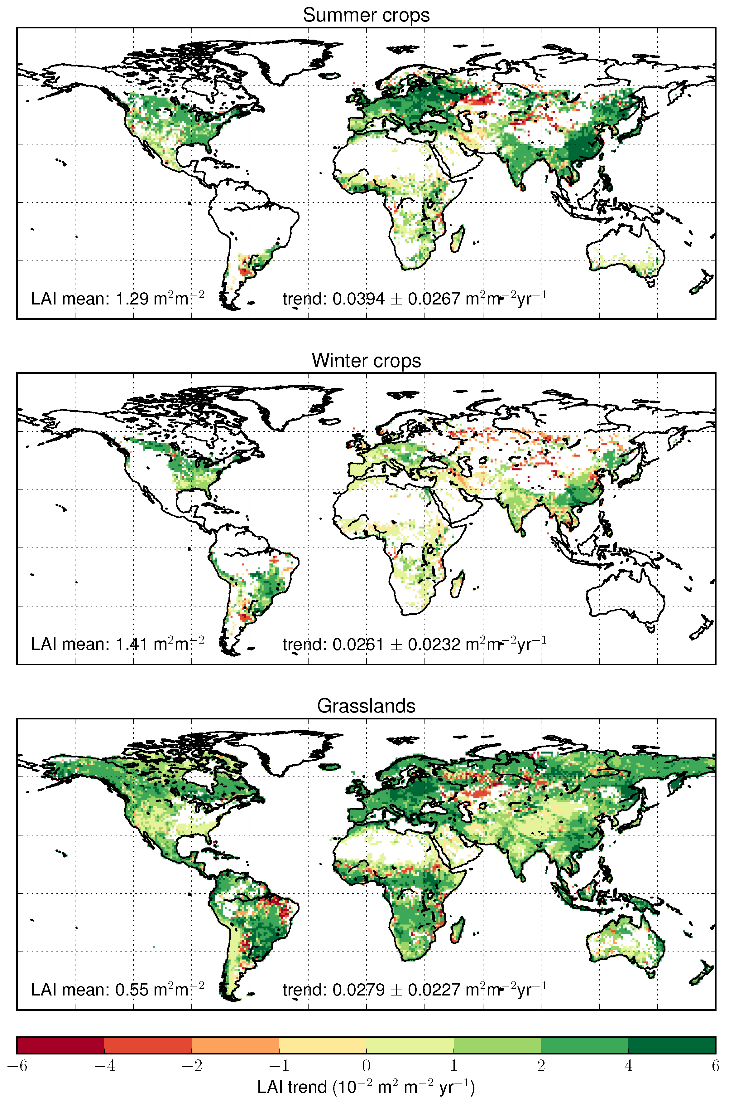
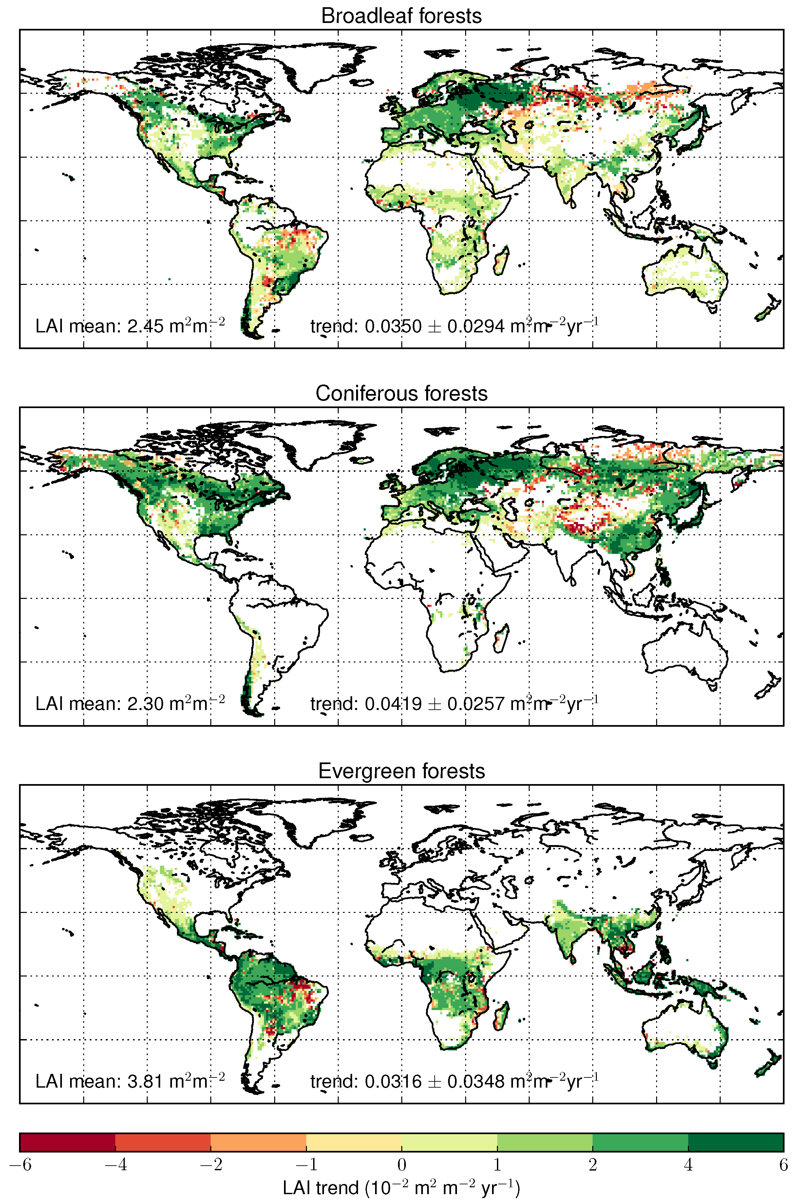
4.2 Vegetative controls on hydrology
Sub-tasks 1 & 2
Example: Water and energy budget
Review models and model parameters used to estimate water balance components to estimate/simulate infiltration and runoff
Design methodology to estimate evapotranspiration using remote sensing measurements and modeled vegetation parameters, such as leaf area index, root depth, and root mass
Correlate ET term with remote sensing measurements and modeled vegetation parameters
Develop algorithms to estimate root depth from remotely sensed measurements and modeled vegetation parameters
Example: Satellite measurements of vegetation parameters (Leaf Area Index)

Slide 8
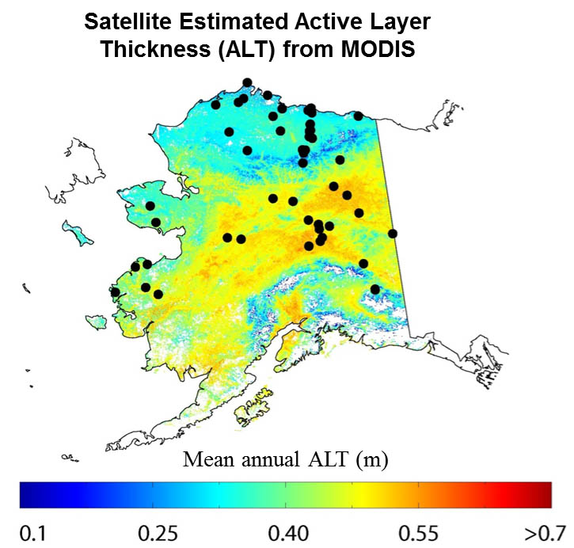

4.2 Vegetative controls on hydrology.
Sub-task 3
Examples: Active Layer Thickness (ALT) succession and satellite estimates of ALT
Develop a methodology to estimate evapotranspiration at high latitudes using vegetation indicators
Literature review: Permafrost active layer hydrologic succession
ET lab experiments: Permafrost active layer vegetation root depth succession-
ET field measurements: Permafrost active layer vegetation root depth succession-
Undisturbed
Disturbed
50 ft
Active
layer
75 ft
50 ft
Permafrost

Slide 9
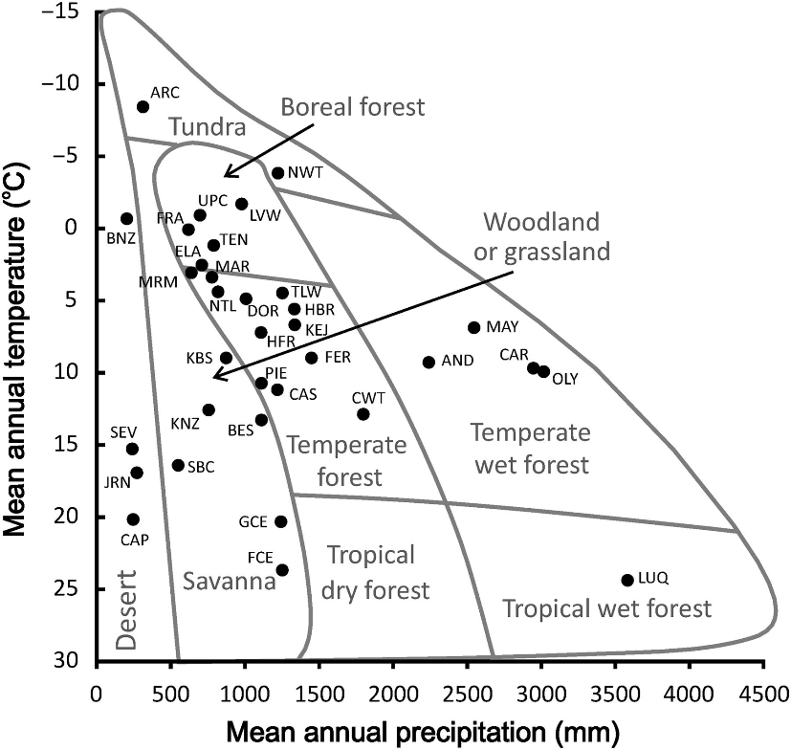
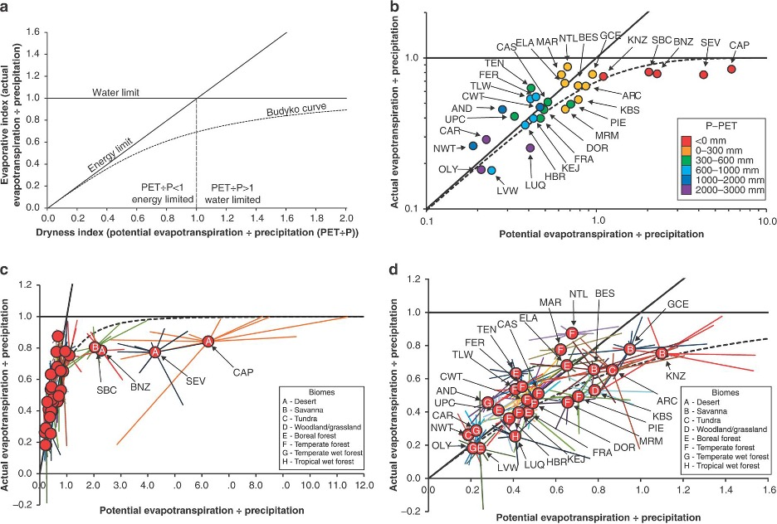
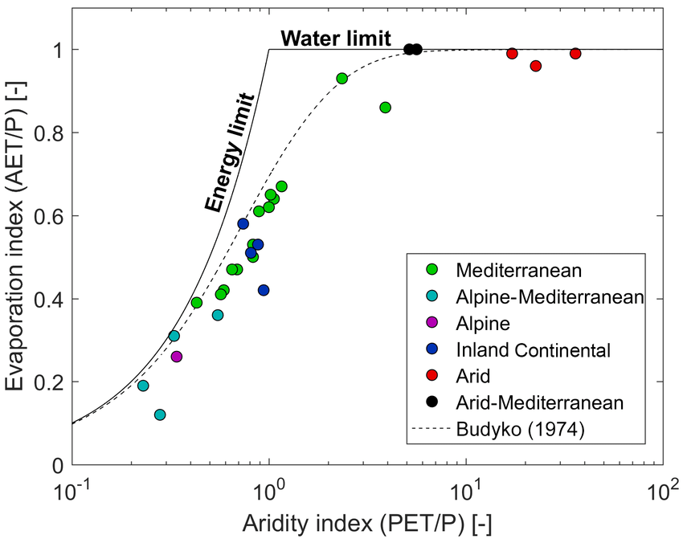
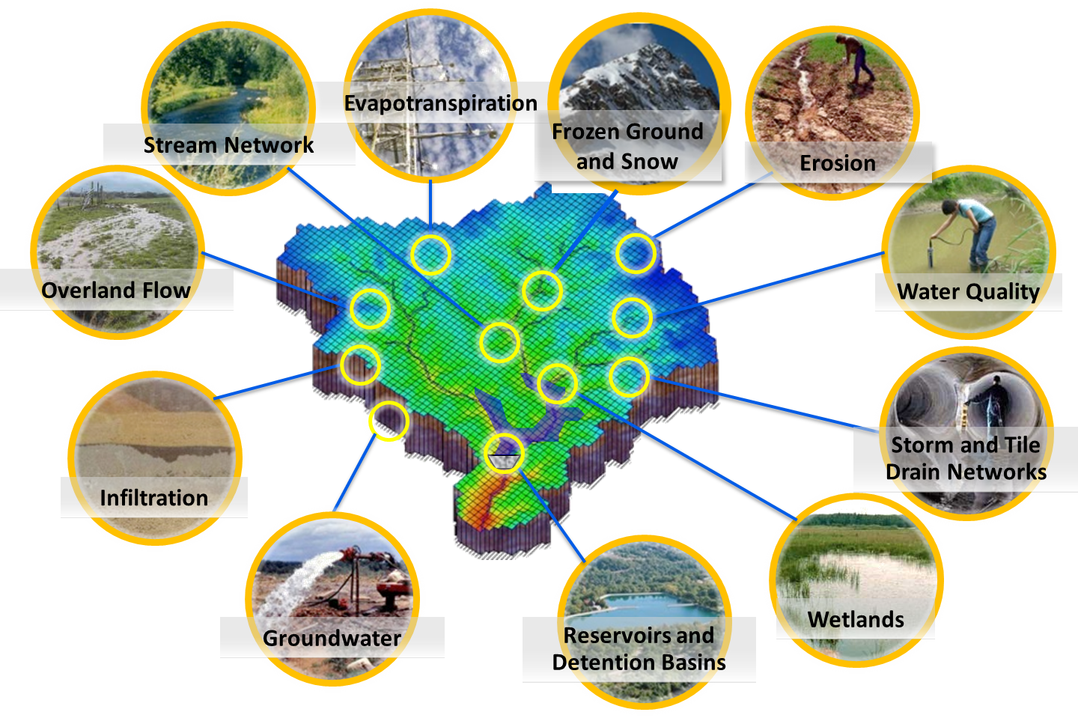
4.2 Vegetation controls on hydrology Sub-task 4
Examples: Budyko curves. Ecosystem types can be broadly distinguished by energy and precipitation.
Develop a process-informed stochastic hydrologic-vegetation model
Develop a Machine Learning (ML) methodology to derive parameters for a stochastically based hydrologic model using a high-resolution hydrologic model (GSSHA) and remotely sensed data
Develop ML methodology to use Budyko (1974) relationships to derive vegetation parameters and relate these measurements to local climate conditions and trends
Develop and test hydrologic-vegetation model using a case study
Example: Integrated hydrologic-vegetation system model

Slide 10
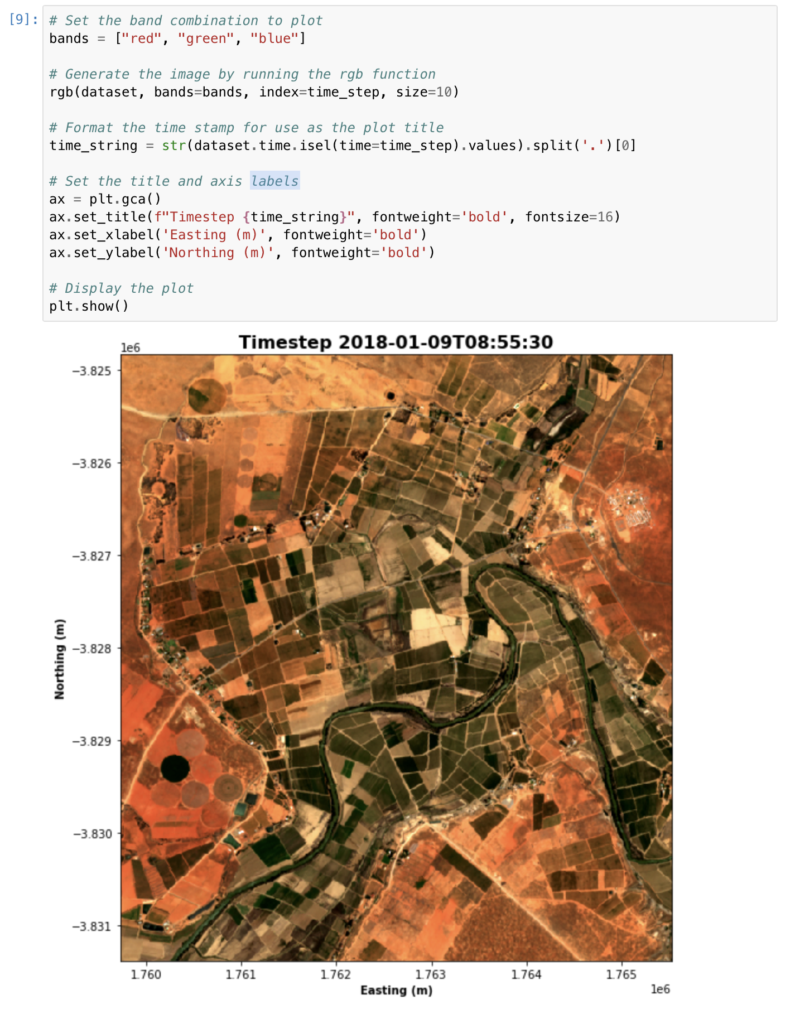
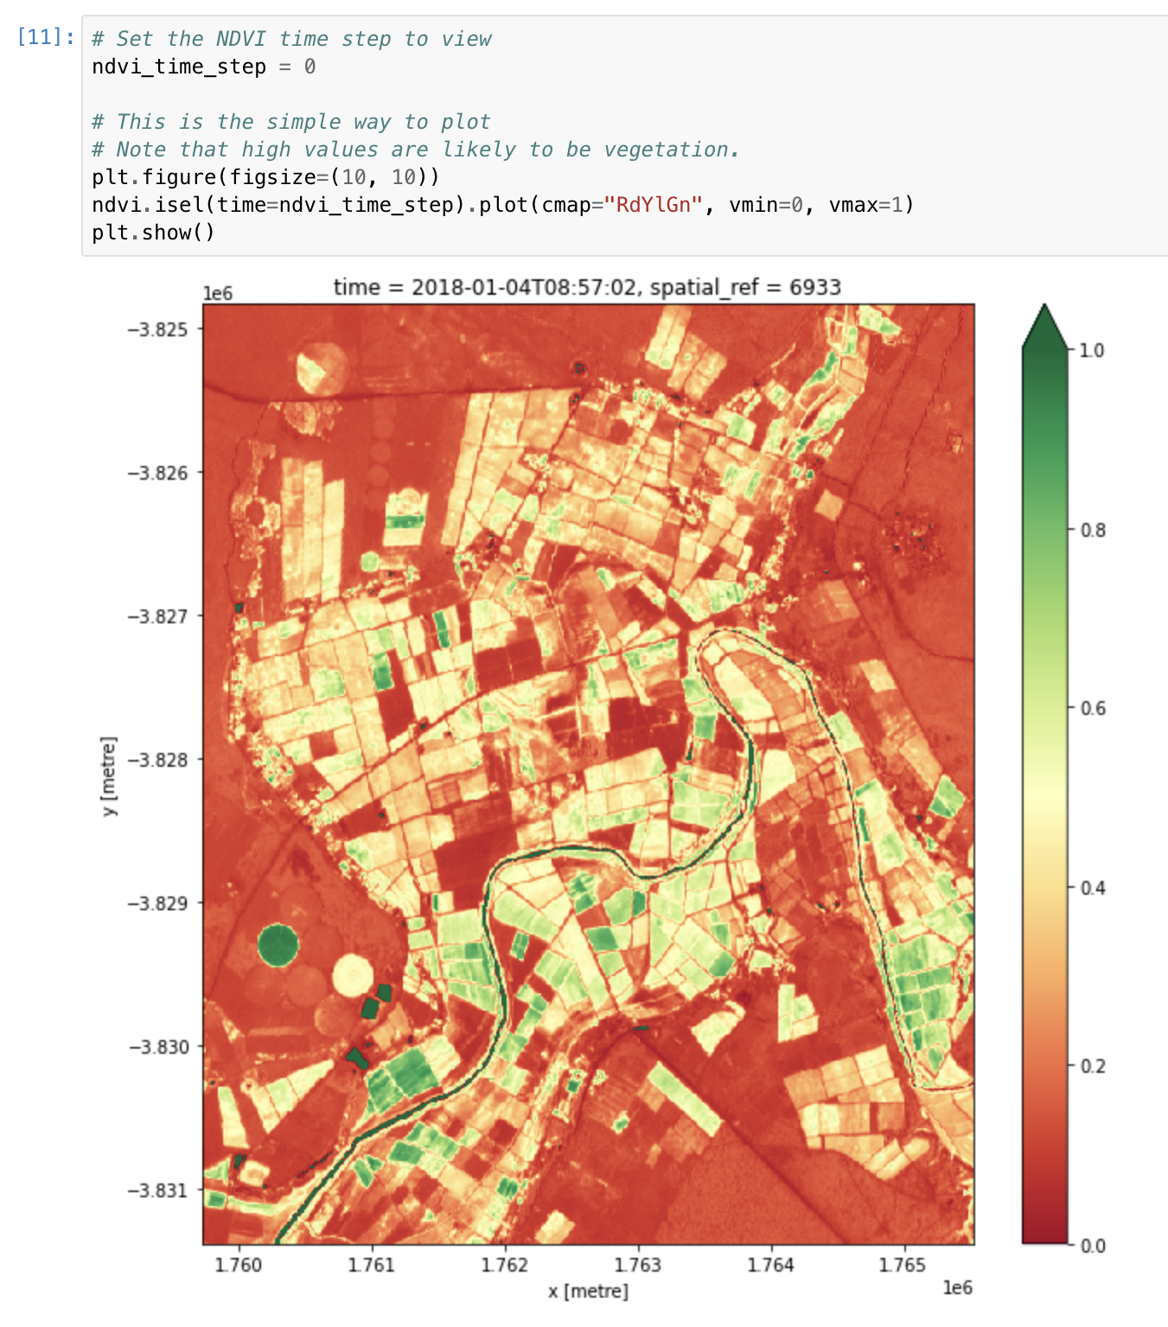
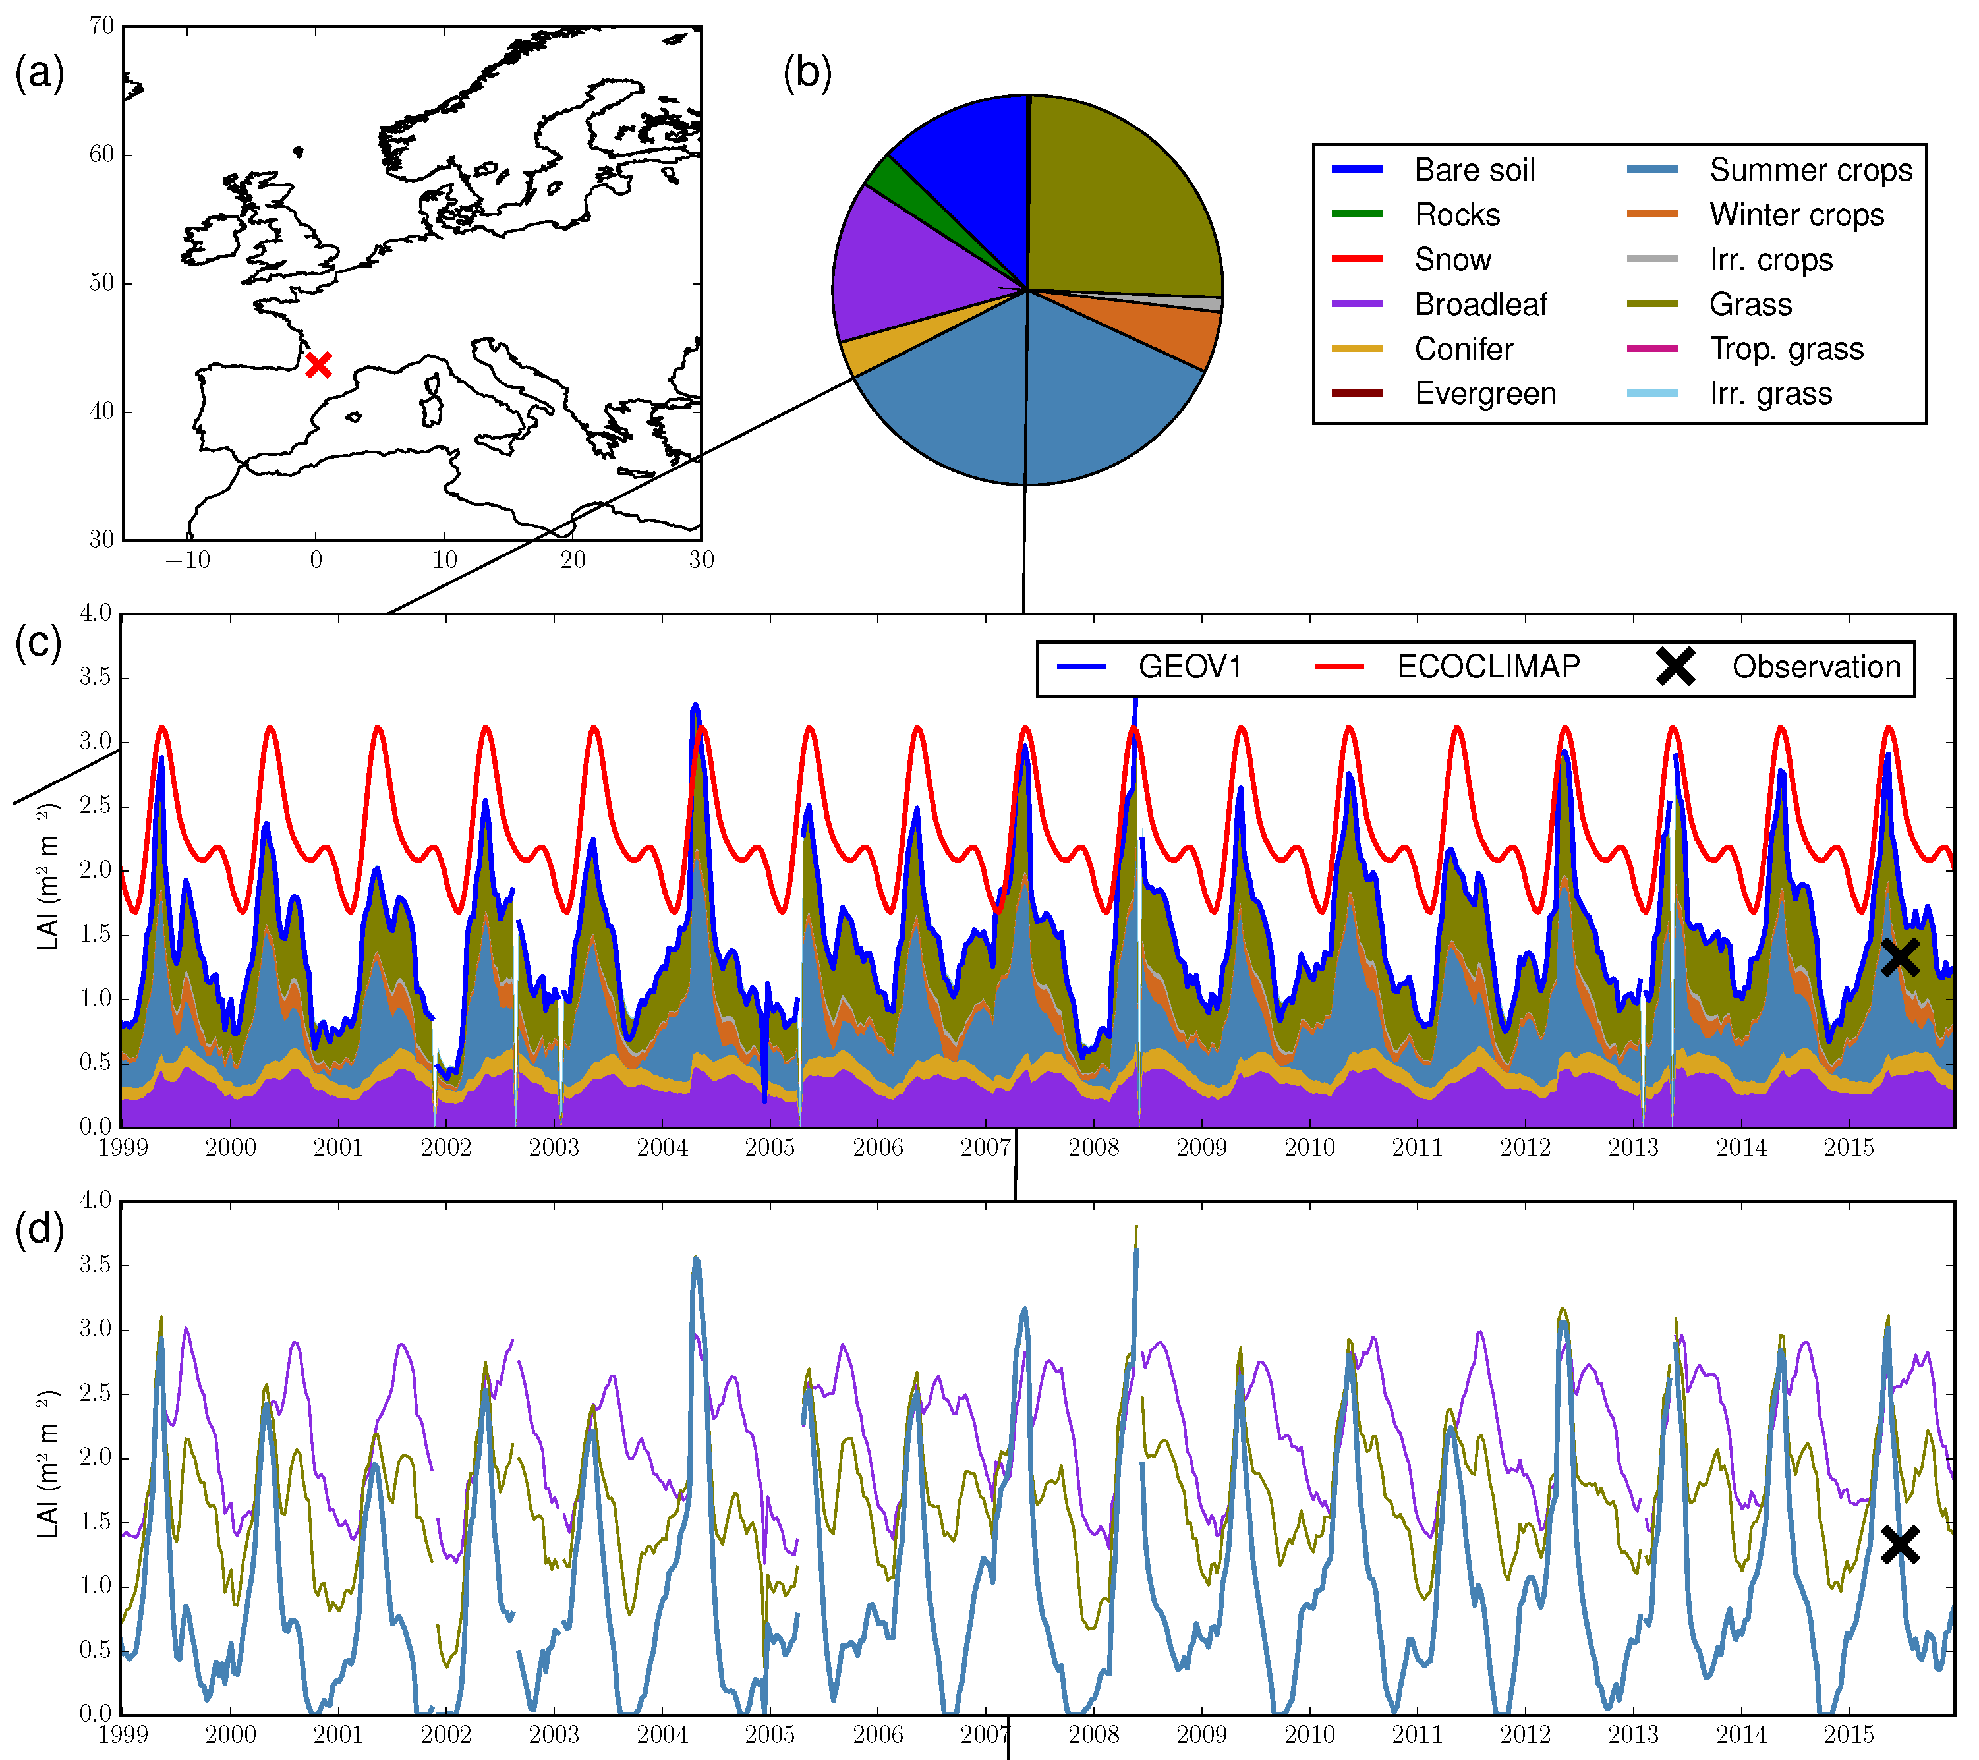
4.2 Vegetative control on hydrology
Sub-task 5-6
Examples: Geospatial and time series data analysis
Data and model analysis
Journal papers/Technical Report

Slide 11
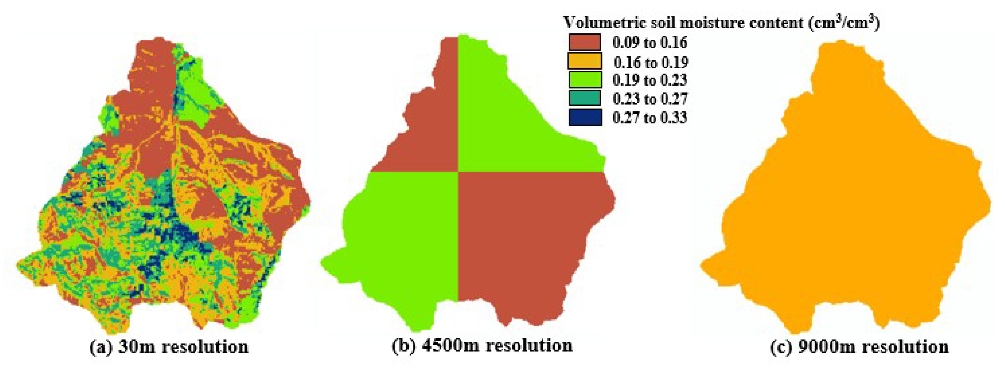
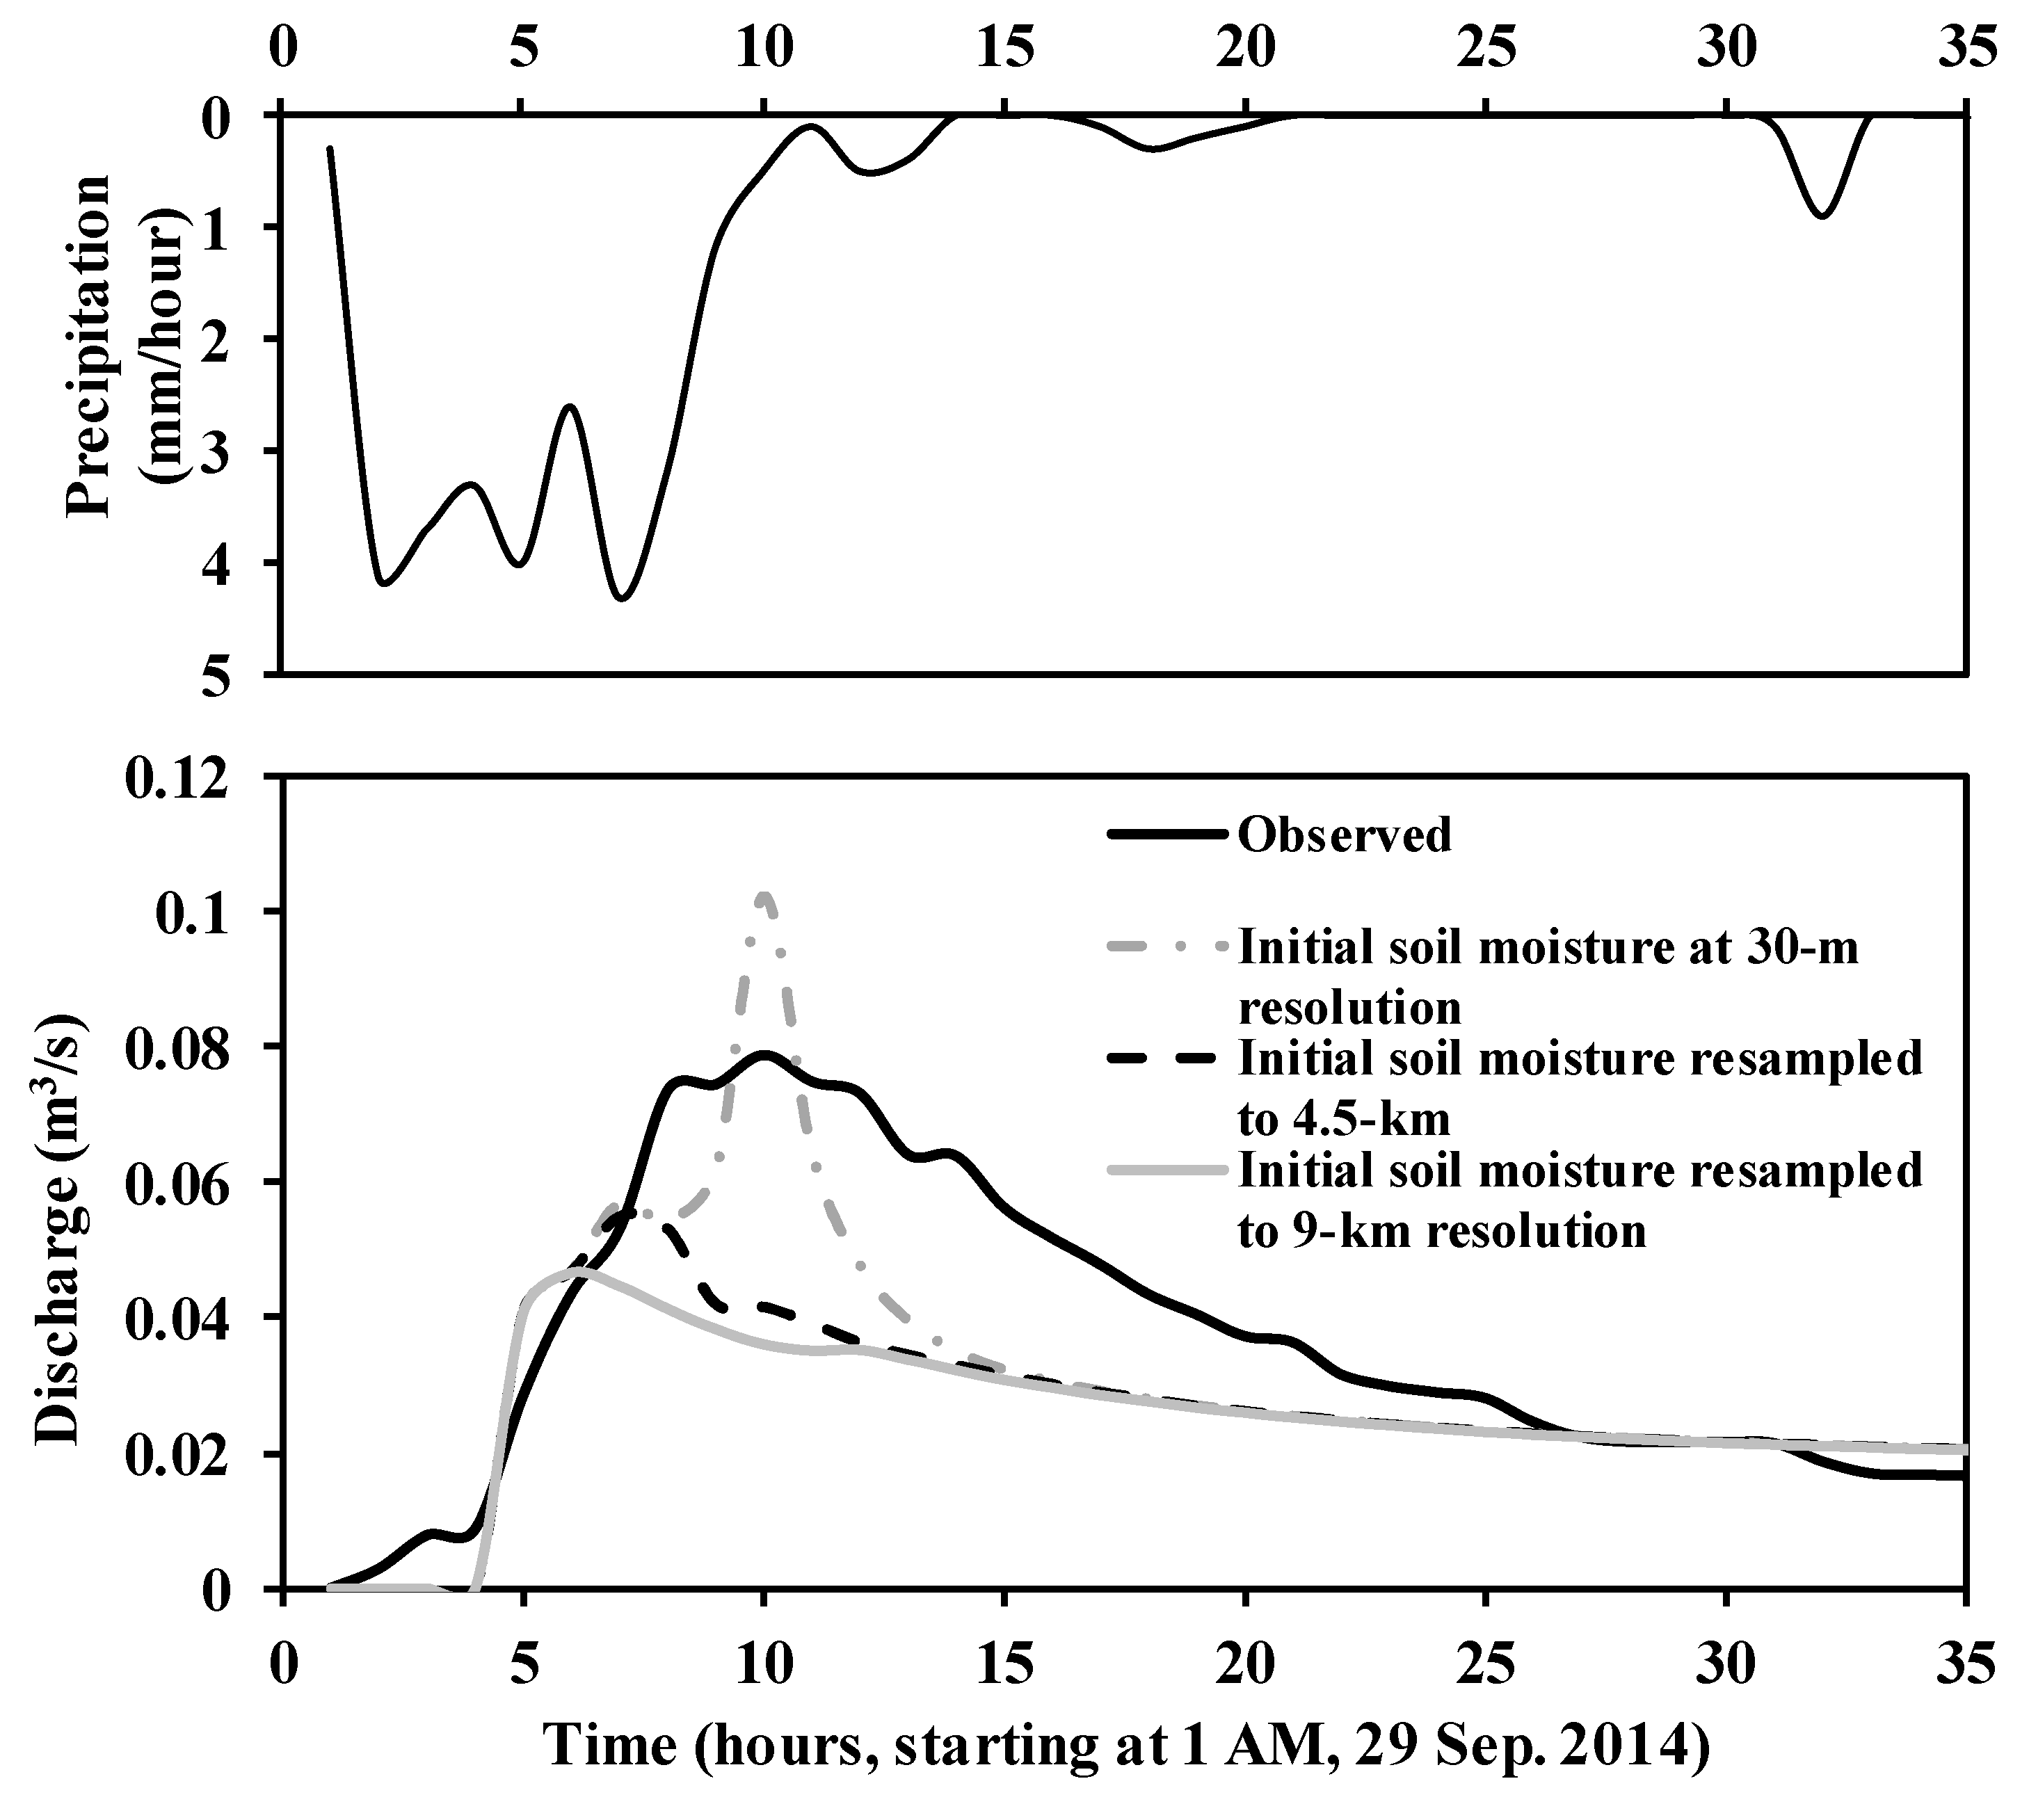
4.3 Spatially distributed soil moisture and run-off,
Sub-task 1 – Developing parameter values and initial
conditions from satellite data.
Example: Soil moisture initial condition effects
Initial condition exert a major role in hydrologic response.
Initial condition estimation and parameter value identification are not the same.
Development of initial condition estimation method/ estimation method options plays a significant role in predicting a hydrologic state or hydrologic state variables.
Along with parameter identification, this work unit will focus on developing methods to initialize key hydrological process: runoff generation processes, base-flow, thermodynamics.

Slide 12
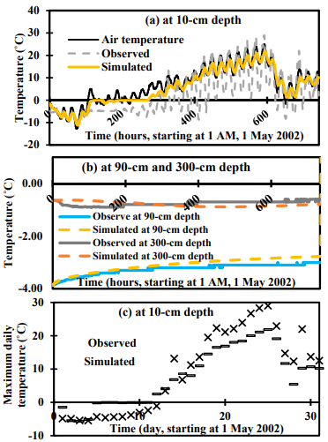
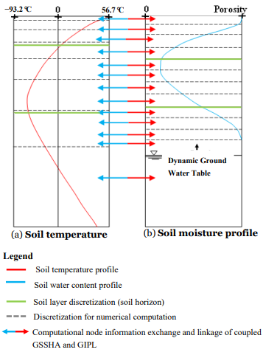
4.3 Spatially distributed soil moisture and run-off,
Sub-task 2 – Simulation of hydrology in permafrost region
TASKS
Enhance coupled GSSHA/GIPL model
Research improved numerical efficiency
Analyze climate change effects on soil temperature
Provide active layer maps
Update GUI for new developments
Coordination with ECW
Hydro-dynamics / thermo-dynamics linkage
Active layer estimation

Slide 13
List of Collaborators/ Leveraged Projects across ERDC
Leveraged Projects | Direct or Reimbursable/Lead Lab | Communication Strategy
Microhydro | Direct Add /CERL | TBD
Hydro-modeling enhancements | Reimbursable/CHL | Monthly meetings with sponsor to ensure collaboration without overlap of efforts
Flood Mapping of Mill Creek, TN | Reimbursable/CHL | Monthly meetings with sponsor to provide updates on the projects progression.
USACE MVD Future Floods | Direct/CHL | Bi-weekly team meetings to track project progression.
Wild-fire hydrology | Reimbursable/CHL | TBD/monthly
Ecofutures/EcoMod | Civil Direct | Quarterly meetings with team/sponsor
ACTIONS | Military Direct | Quarterly meetings with team/sponsor
Many projects provide useful products to incorporate into IEBA
IEBA is the mechanisms to enhance, integrate, and field these products in a cohesive system
FORGE THE FUTURE
Notes:
Slide 13- Army recommendations here?
Response: Similar to Heilmeier question - If successful in solving the problem, what difference will it make and why? Who cares? The operational gap the Project is addressing, quantify the metric planned to achieve.
Freeform vs guided chart – Kim will address during discussions.

Slide 14
Coordination
Simulation of hydrology depends on data/input/knowledge about terrain, soils, weather, vegetation, land practices, and topology of these features.
The hydrology task has overlap with every other task: soils, vegetation, ECW, and integration (mapping).
The hydrology tasks will both use, and provide, information to overlapping tasks.
Continuous flow of information across tasks
Data sharing
Common demonstration sites
Interchange of methods/knowledge
Prevents duplication of efforts and maximizing utility of products from other tasks

Slide 15
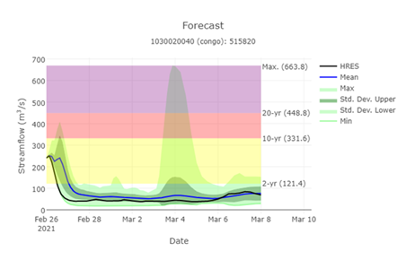
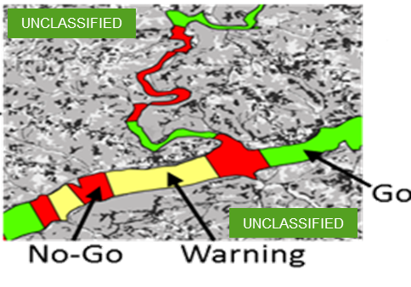
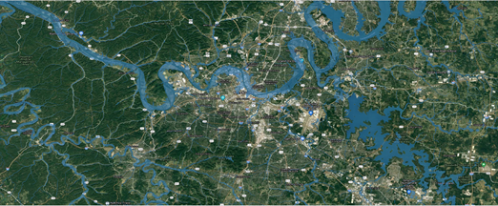
Expected Outcomes, Impact & Payoff
The current patchwork of hydrologic and hydraulic support results in non-authoritative and sometimes conflicting analyses originating on non-accredited networks that are too often available only after the fact.
Decision makers on secure and accredited networks need timely, authoritative, information on hydrology and hydraulics at nearly any location around the globe.
The developed computing infrastructure will centralize, aggregate, automate, and report data to global hydrologic and terrain states that can feed into downstream applications (e.g., wet gap crossing analysis).
Mapped Hydrologic Output for decision making or for additional analysis (i.e. trafficability)
Input Data (raw or reduced)
Analysis Tools and Hydrologic Output
From Streamflow to Decision Support
FORGE THE FUTURE
Notes:
Slide 13- Army recommendations here?
Response: Similar to Heilmeier question - If successful in solving the problem, what difference will it make and why? Who cares? The operational gap the Project is addressing, quantify the metric planned to achieve.
Freeform vs guided chart – Kim will address during discussions.

